Slide 1
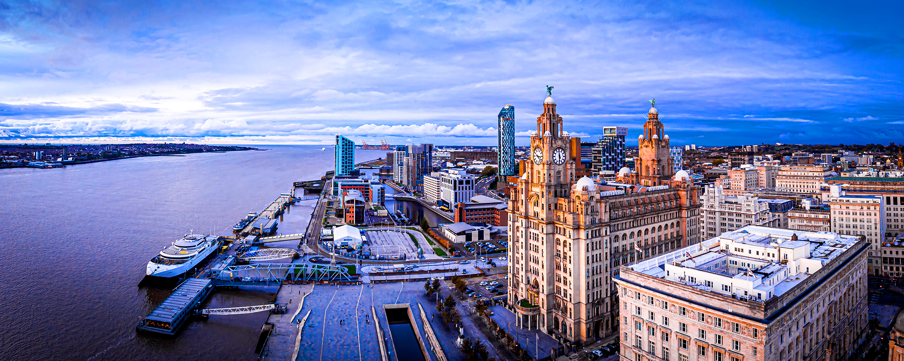
Year 5 Liverpool Residential
Thursday 13th June- Friday 14th June 2024

Slide 2
General Info:
KT coaches will be transporting us for the duration of the trip.
The driver will be staying in Liverpool and will be available if needed.
Children will need a backpack with their lunch, water bottle, coat etc. in, as well as a small suitcase or overnight bag (these will stay on the coach throughout the day).
Mrs Williams will be coming, other adults tbc.

Slide 3
Thursday 13th June 2023
Children will need to arrive at school at 8am, we will be walking down to the college at 8:30am aiming to be on the road at 8:45am.
Travel sickness medication to be taken beforehand. Spare medication needs to be given to me in named envelope with instructions written on.
Journey estimated to be 1hr 30 mins.

Slide 4
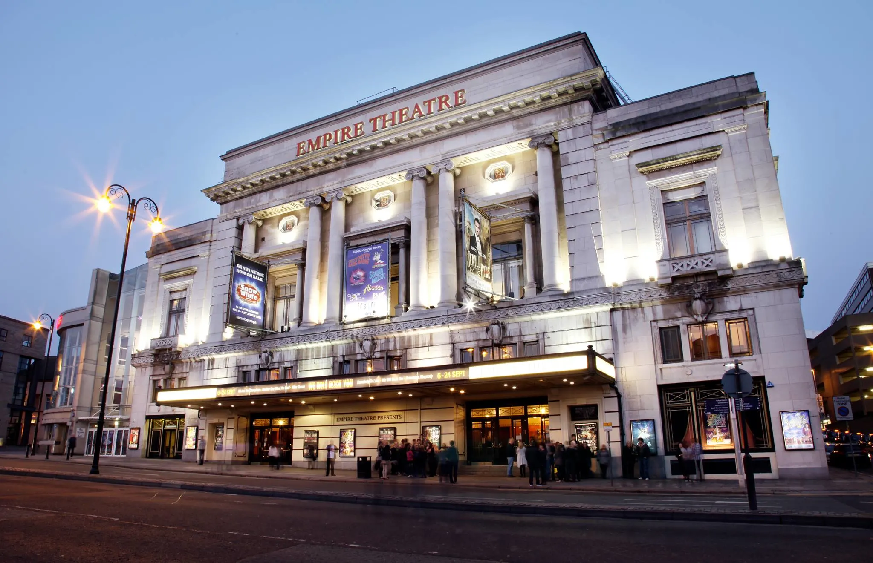
Liverpool Empire Theatre @ 10:30am

Slide 5
Liverpool World Museum
This is a 5 minute walk from the theatre.
We will be having lunch when we arrive, children will be asked to bring a packed lunch.
At 1:15pm we will be taking part in an Egyptian Mummification Workshop. We will then have time to explore the museum before heading to the accommodation.
https://www.liverpoolmuseums.org.uk/schools-and-groups/workshops/ancient-egyptian-mummification

Slide 6
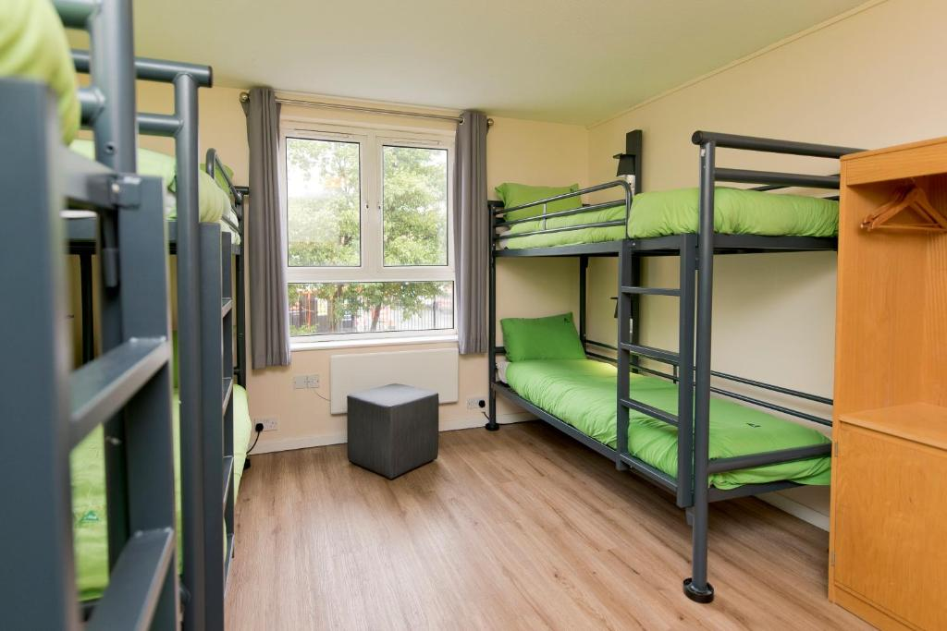
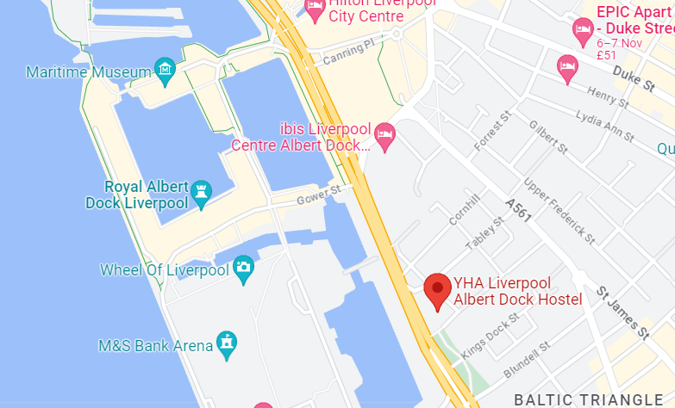
YHA Liverpool Albert Dock
Average 6 per room.
Bedding provided.
Lockable doors.
School rooms ‘zoned off’ from other areas.

Slide 7
Rooming's
Separate boys and girls rooms.
Children will have the opportunity to suggest two children they would like to share with.
Teachers will then organise the groupings according to room sizes.

Slide 8
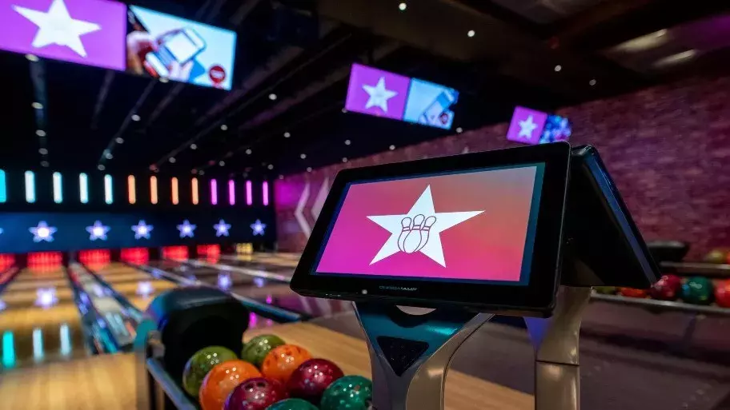
Tea and Bowling
Tea (TBC) at the YHA, chill time to settle in.
6:00pm- Coach to take us to Hollywood Bowl for a game of bowling.
Back to YHA: showers, settle and bed.

Slide 9
Friday 14th June 2023
8:00am- Breakfast and packing.
Packed lunches for the day will be sorted.
Suitcases onto the coach, which will drive around to meet us at Eureka.
Weather depending we will be taking the 10 minute Ferry journey across the River Mersey to Eureka Science and Discovery (coach on reserve).

Slide 10
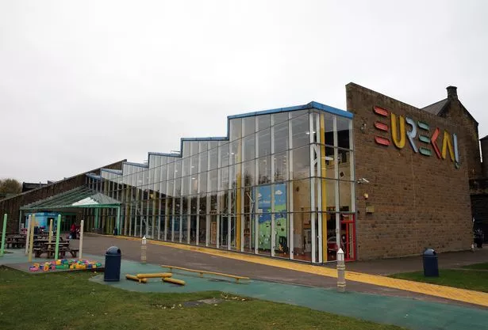
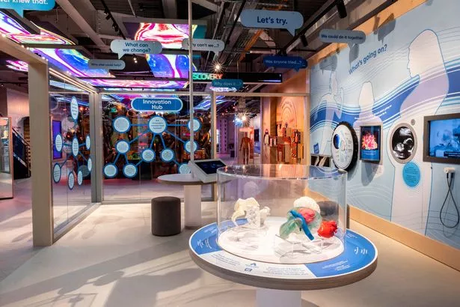
Eureka
10:00am- Day exploring the museum in groups inc. Gross Lab Science Show.
2:00pm- Leave for school.
You will be kept informed on the expected arrival time, children to be collected from Kendal college.

Slide 11
Kit List
Children are to travel in their own clothes with logoed school jumper or cardigan, please wear sensible footwear as we will be doing lots of walking.
Spare clothes for next day
Pyjamas
Underwear
Towel
Toiletries inc. toothbrush, toothpaste, shampoo, conditioner, showergel etc.
Book, teddy, small game (no Electronics or footballs sorry!)
School bag
Named water bottle
Waterproof coat
Sun cream and sunhat
Spending money for the museums, maximum amount of £10, children to be responsible for this.
A couple of healthy snacks

Slide 12
Payment Schedule
31st October £20
30th November £20
31st January £20
29th February £20
29th March £20
30th April £20
31st May £25

Slide 13
Any Questions?

